Slide 1
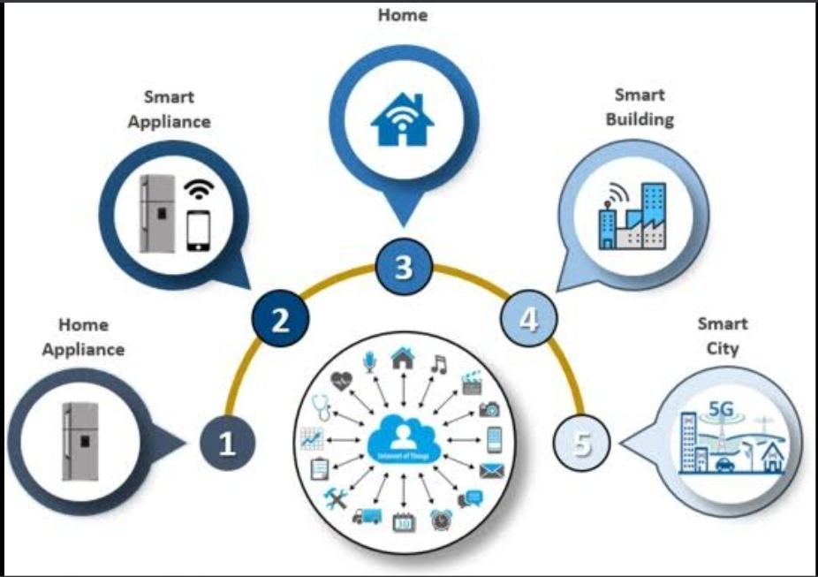
Picktrendy
CMR INSTITUTE OF TECHNOLOGY
Coordinator:- Mr.Veeresh
K.Sindhu (18R01A05F1)
K.Sahithi (18R01A05F2)
M.Divya (18R01A05F5)
G.Divya (18R01A05D7)
V.Nirosha (18R01A05H7)

Slide 2
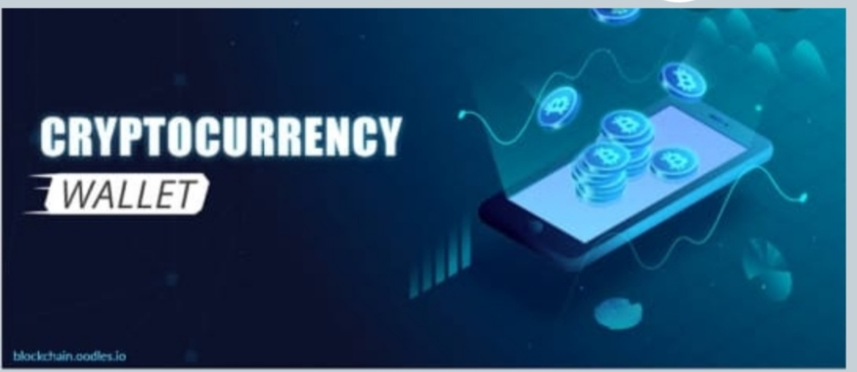
introduction…..
What does it mean if we say digital wallet for connected things…..??
What is Digital Wallet….??
Digital Wallets are digital versions of your credit and debit cards stored in an app on your mobile device.
IOT Devices
Can there be alternate way of
making payment other than the
Conventional banking route…??

Slide 3
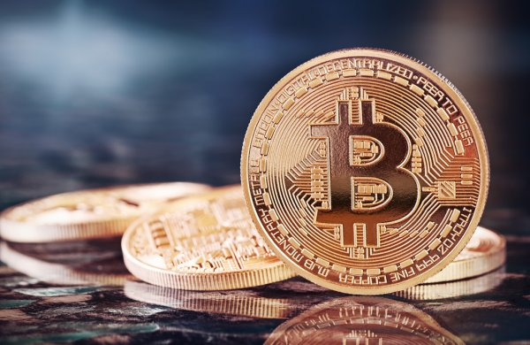
Which type of cryptocurrency are we using….??
BITCOIN ,it is a digital currency , which is stored in digital wallet application on a smart phone/computer.
Every single transaction is recoded in a public list called the “block chain”.
Blockchain-enabled iot…..??
All information transmitted from IoT devices are recorded on the Blockchain . This means that goods can be digitally identified and protected from fraud.

Slide 4
Pains in digital wallet:-
Transaction Charges.
Difficult Design.
Insecurity.
Lack of trust.
Requirement of External source and authority.
Verification and Validation issues.
Single entity control.
Components can be reprinted with unauthorized manufacturer with less valuable material.

Slide 5
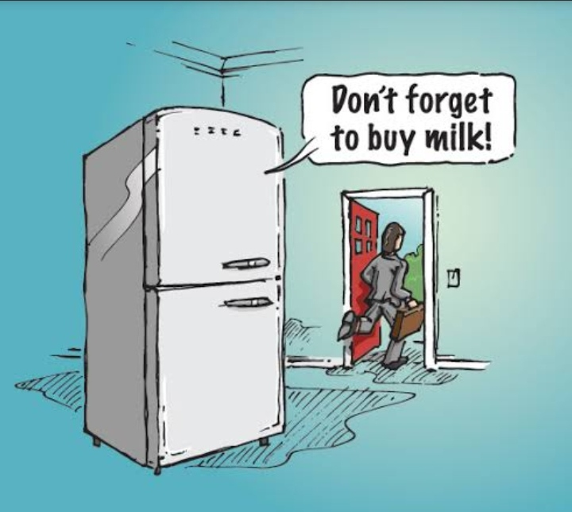
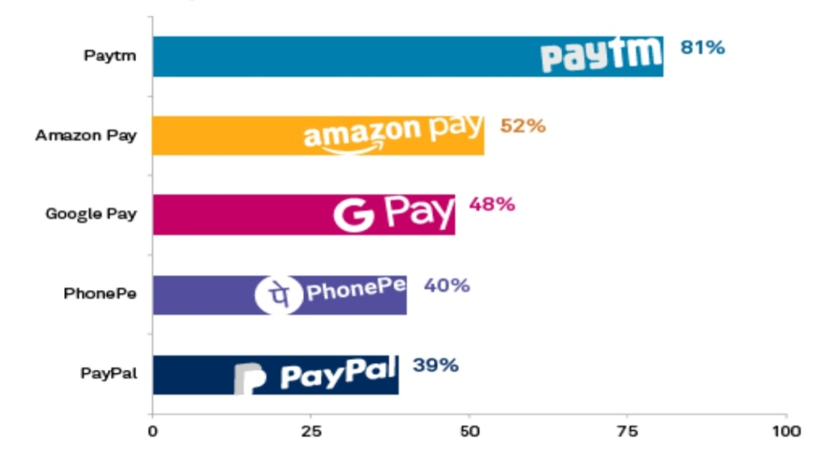
Target segment….
In our project, we are focusing on process of payment-(Digital Currency) automatic payment done by a machine .
We are going to use IoT device-”weight sensors”
According to the wait of the product in the machine , it automatically places an order.
Eventually it makes a payment.

Slide 6
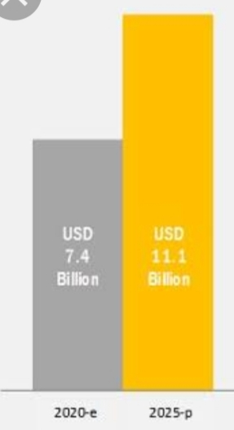
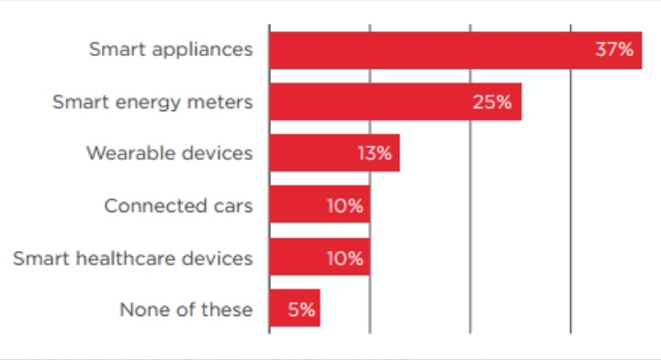
Market size…??
The refrigerator monitoring market is projected to reach USD 11.1 billion by 2025.
The growth of the market can be attributed to the increasing demand for high quality packed food products.

Slide 7
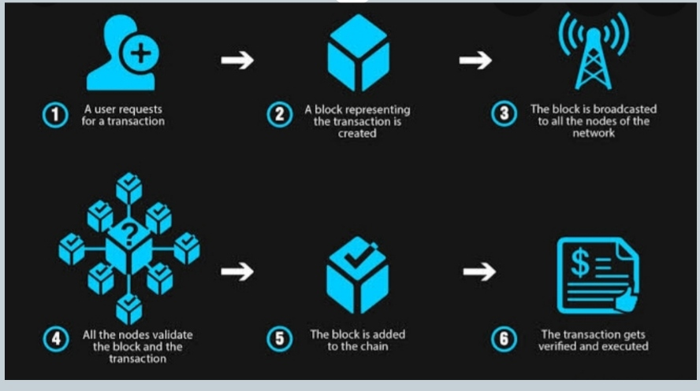
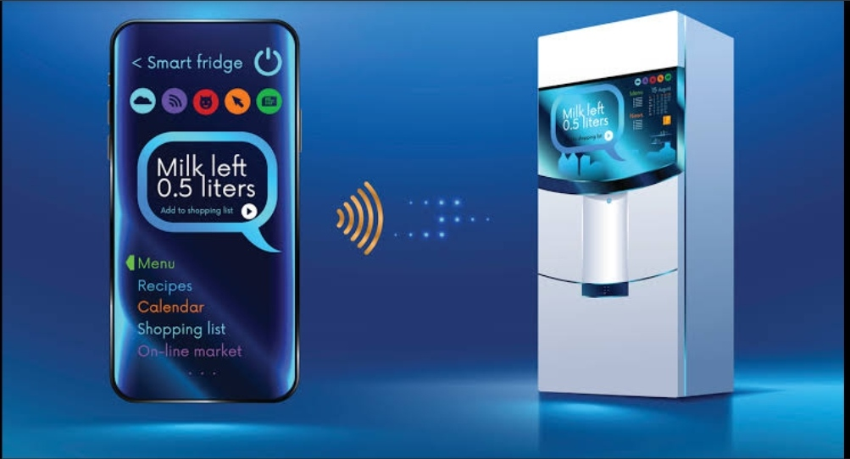
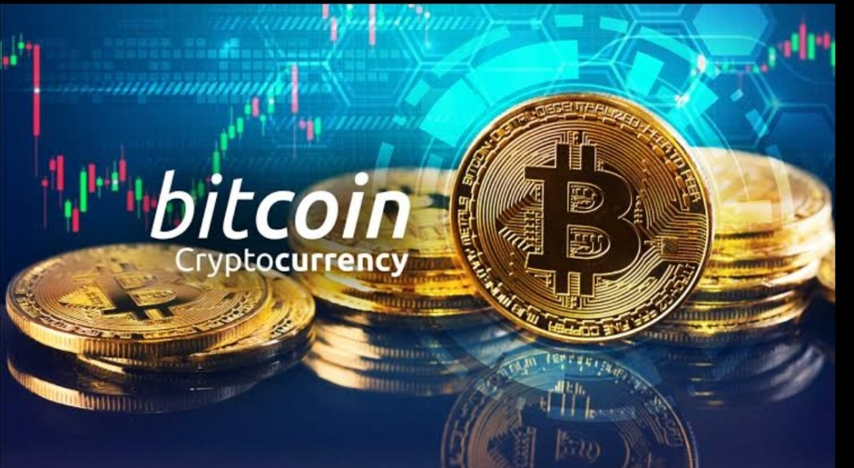
Architecture
Smart IoT device
Block Chain..
Happy Payment..!

Slide 8
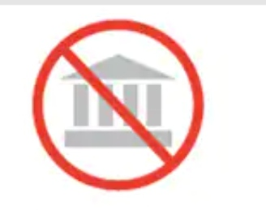
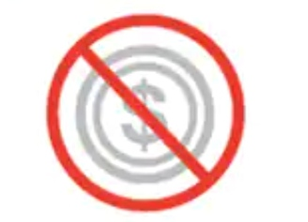
Solution…
USP(Unique Selling Proposition)
Features→ Security
Cost
Scalability
Time to Market….
Technologies involved

Slide 9
Conclusion
User Autonomy
Discretion
Peer-to-peer Focus
Elimination of Banking Fees
Very Low Transaction Fees for International Payments
Mobile Payments
Accessibility

Slide 10
THANK YOU

